Slide 1
Quick sort
Youssef omar 222657

Slide 2
7
9
11
5
6

Slide 3
5
6
11
7
9

Slide 4
5
6

Slide 5
11
7
9

Slide 6
7
9
11
7
11

Slide 7
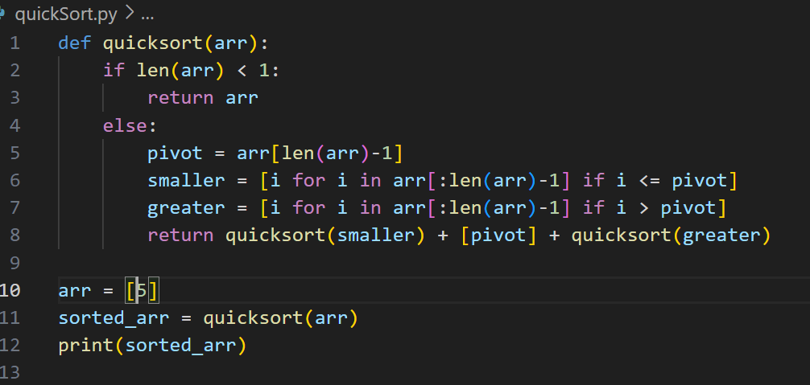
code

Slide 8
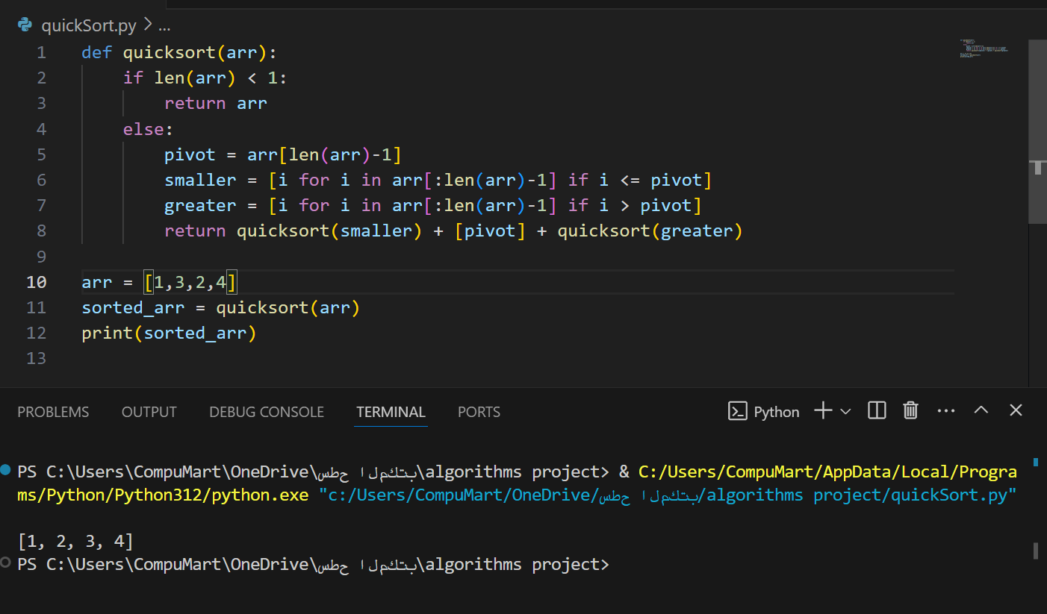

Slide 9
Worst case
T(n) = T(n - 1) + n T(n-1) = T(n-2) + (n-1)
T(n) = [T(n - 2) + (n - 1)] + n T(n - 2) = T(n - 3) + (n - 2)
T(n) = [T(n - 3) + (n - 2)] + (n - 1) + n
T(n) = T(n - k) + (n - k + 1) + (n - k + 2) + ... + (n - 1) + n

Slide 10
(n - k) = 1
*n - k = 1
*k = n - 1

Slide 11
T(n) = T(n - (n - 1)) + (n - (n - 1) + 1) + (n - (n - 1) + 2) + ... + (n - 1) + n
T(n) = T(1) + 2 + 3 + ... + n

Slide 12
Sum of numbers from 1 to n = n * (n + 1) / 2
Sum of numbers from 2 to n = (n * (n + 1) / 2) - 1

Slide 13
T(n) = T(1) + (n * (n + 1) / 2) - 1
T(n) = 1 + (n * (n + 1) / 2) - 1
T(n) = n * (n + 1) / 2
O(n^2).

